Slide 1

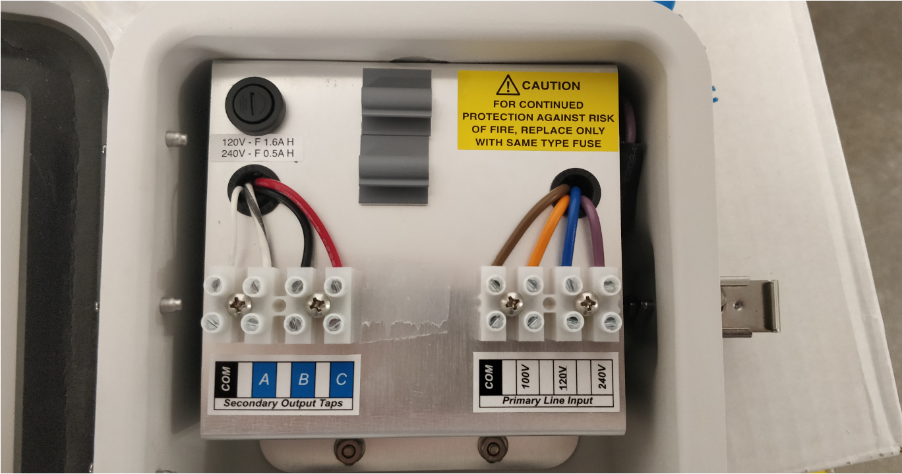
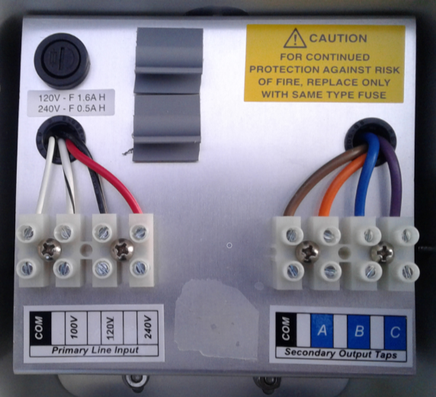
QUALITY ALERT
Title: WCS1-4 Primary/Secondary Label Placement
Models Affected: WCS1-4
Picture of Defect
Picture of Good Part
What is the problem:
The primary and secondary terminal labels may be incorrectly placed, potentially leading to incorrect wiring of the input and output terminals during installation.
Actions Required:
Inspection of the input/output label placement is required to ensure correct wiring of the WCS1-4 primary and secondary terminals.
Note: as demonstrated above, the correct label placement has the Primary (Input) label under the connector housing the white, white/brown, black and red wires; while the Secondary (output) label will be under the
connector housing the brown, orange, blue and purple wires.
Please contact your local Pelco support team or email Pelco_Quality@Pelco.com for immediate resolution if a unit is found to be non-conforming.

